Slide 1
Sudoku Solver Using Genetic Algorithm
Presented by
Joe Milne, Radeeb Bashir, and Rohan Saha
Notes:
Need to modify presentation so that it aligns with what we have been doing. Currently has been just copy-pasted into this file. Please leave updates on the respective slides. Thanks.
-Joe

Slide 2
Overview
History of Sudoku
Genetic Algorithm
Proposed Methods
Parameter Optimization
Experiments and Results
Conclusion
References

Slide 3
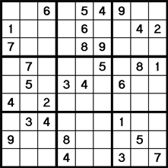
History of Sudoku
Sudoku is a Japanese word consisting of two parts, “su” and “doku” which means number and single respectively
The objective of the game is to take a 9×9 grid and fill in the open spots with numbers from 1 to 9 so that each column and each row of the grid contains each of the numbers only once.
Furthermore, each of the nine 3×3 sub-grids that together compose the total 9×9 grid (also called boxes, blocks, regions, and sub-squares) must contain all of the digits from 1 to 9 only once.
The first Sudoku was published in a puzzle magazine in USA, 1979

Slide 4
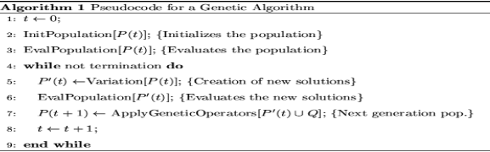
Genetic Algorithm
Genetic Algorithm is an algorithm that imitates the process of natural selection
The concept of genetic algorithms is a search technique often used in computer science to find complex, non-obvious solutions to algorithmic optimization and search problems

Slide 5
Proposed Method - Representation
To represent the Sudoku puzzle in a Genetic Algorithm, we represent each chromosome as a two dimensional integer array of size 9*9, with these conditions:
The numbers predefined by Sudoku setter should be fixed in their corresponding position in the chromosome and cannot be changed
Each row of the chromosome should contain numbers from 1 to 9 only once
Each 3*3 sub-square of the general grid should also contain numbers from 1 to 9 only once

Slide 6

Proposed Method – Fitness Function
The proposed Fitness Function for each chromosome is considered to be
F(x) = Maximum Possible number of mismatch – (Total number of mismatch)
Where, the maximum possible number of mismatches that a Sudoku puzzle can have in the worst case is 81
As the chromosomes are generated randomly, there is high probability of being selected as a parent for all the chromosomes.
Therefore, the fitness values are further normalized using max-min normalization to smaller interval of [5, maxValue]

Slide 7
Proposed Method - Crossover
Two chromosomes from the generated population are selected as parents, with the probability of selection being proportional to their fitness values.
Two children are generated with the first one having randomly two of sub-square rows from one of the parents and one from the other, and the second child having the sub-square rows of the parents not used by the first child.
Crossover operation happens by a probability crossoverProb. If the operation does not happen, the parents go to the next generation without any changes.

Slide 8
Proposed Method - Mutation
Two different mutation operations are used
Mutation of Gene: A cell in the matrix is selected and swapped with another cell of the matrix of the same row. Then if the new chromosome is not valid according to our constraints, we change the same numbers of these two genes in the other two matrix rows of the same sub-square row to get a valid chromosome. This mutation in the chromosome is controlled by probability “mutationProb1”
Mutation of Sub-Square rows: Each time a mutation is happening to a sub-square row, that row is completely replaced by a newly generated row. This mutation in chromosomes is controlled by probability “mutationProb2”

Slide 9
Proposed Method – Other Criteria
Maximum number of generations for solving a single Sudoku puzzle to be 100,000
After each ten thousand generations, if a solution is not found then all chromosomes are killed and a new population of chromosomes are generated

Slide 10
Parameter Optimization
To find the optimal values of four proposed parameters “crossoverProb”, “mutationProb1”, “mutationProb2”, and “maxValue”
Initial value of crossoverProb = 0.8, mutationProb1 = 0.2, mutationProb2 = 0.02, and maxValue = 20 was assigned
To find the optimized values of the parameter, each time they fixed all the parameters except one of the and tried to solve all the twenty Sudoku puzzles for different values of this parameter
Then they assigned points to the values of this parameter according to the number of puzzles it could solve where an easy puzzle had only one point, medium had two points, hard had three points, and finally an evil puzzle had four points.
After summing up the points for each of the values, the value with the maximum total points was selected as the optimized value for that parameter
Notes:
Probably need to delete this slide as it doesn’t really affect what we are doing with our project.
- Joe

Slide 11
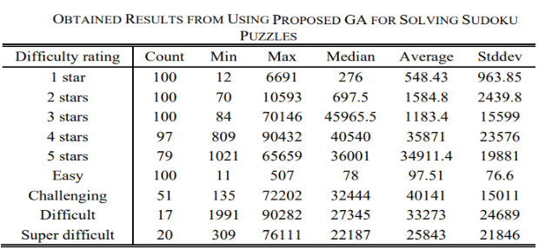
Experiments and Results
Notes:
Probably also do not need this slide.
- Joe

Slide 12
Conclusion
Proposed a more efficient genetic algorithm by generating more controlled chromosomes.
Proposed method is more efficient than other methods available using genetic algorithm
Increases the percentage of solving the puzzles with different difficulties up to 73%
Could not do much better in terms of average number of generations

Slide 13
References
[1] http://waste.org/publications/9998148/a-retrievable-genetic-algorithm-for-efficient-solving-of-sudoku-puzzles
[2] http://www.cleveralgorithms.com/nature-inspired/evolution/genetic_algorithm.html
[3] https://en.Wikipedia.org/wiki/Genetic_algorithm

